Slide 1



Ford Dagenham Engine Plant

Slide 2
Introduction
Ultrasonic Principles
Test Equipment
Test Preparation
Data Acquisition
Documentation

Slide 3
Introduction
The complexity and expense of today’s machines, equipment and tools dictate the use of fabrication and testing procedures that will ensure maximum reliability. Nondestructive testing provides many of these procedures.
The purpose of this training is to present essential knowledge of ultrasonic testing and the testing equipment relevant to ultrasonic case depth testing required by system operator personnel to enable them:
To apply the proper testing technique
Interpret, evaluate and make a skillful decision leading to the test result
Recognize those areas exhibiting doubtful test results that require either re-testing or assistance in interpretation and evaluation

Slide 4
Introduction
Testing Philosophy
Nondestructive testing is used to assure maximum reliability of machines, equipment and tools. To accomplish such reliability, test standards have been established and test results must meet these standards.

Slide 5
Introduction
Personnel
It is imperative that personnel performing ultrasonic testing be trained and qualified with a technical understanding of the test equipment and materials, the part (specimen) being tested and the test procedures.
To make optimum use of ultrasonic testing, personnel conducting tests must continually keep abreast of new developments.
There is no substitute for knowledge.

Slide 6
Introduction
Testing Criteria
Modern manufacturing procedures dictate that faulty parts be discovered as early in the manufacturing process as possible. This means that each item must be tested individually before it is required to perform in a sub-assembly, and that each sub-assembly be tested before it is required to perform in an assembly, etc.
This “building-block” approach requires that test processes be selected and test procedures be generated at the lowest level in the manufacturing process, in order that the highest level of reliability can be obtained at lowest possible cost.

Slide 7
Introduction
Test Procedures
Approved procedures for ultrasonic testing are formulated from the analysis of test specimen, review of its past history, and experience on like or similar specimens.
It is the responsibility of personnel conducting tests to ensure that test procedures are adequately applied, and that the test objective is accomplished.
Procedures found to be incorrect or inadequate must be brought to the attention of responsible supervision for correction.

Slide 8
Introduction
Test Objective
The objective of ultrasonic testing is to ensure product reliability by providing means of:
Obtaining a visual recorded image related to the condition in the specimen (case depth)
Separating acceptable and unacceptable materials or parts in accordance with pre-determined criteria and standards
No test is successfully completed until an evaluation of the test results is made. Evaluation of test procedures and results requires understanding of the test objective as well as knowledge of the material being tested.

Slide 9
Ultrasonic Principles
General
Ultrasonics is the name given to the study and application of sound waves having frequencies higher than those the human ear can detect.
Ultrasonic nondestructive testing is the use of ultrasonics to examine or test material without destroying the material. An ultrasonic test may be used to examine the internal structure of a part for possible discontinuities, such as voids or cracks, or to measure the thickness of a material, e.g. the depth (thickness) of the case.
Test frequencies commonly range from 500kHz (500,000 cycles per second) to 25MHz (25,000,000 cycles per second).

Slide 10
Ultrasonic Principles
Sound – Energy in Motion
Sound is the mechanical vibration of particles in a medium (material). When sound waves travel in material, the particles in the material vibrate about a fixed point at the same frequency as the sound wave. The particles do not travel with the wave but only react to the energy of the wave.
It is the energy of the wave that moves through the material.

Slide 11
Ultrasonic Principles
Modes of Vibration
If the length of a particular sound wave is measured from peak to peak, the distance is always the same. This distance is known as the wavelength (λ). The time it takes for the wave to travel a distance of one complete wavelength is the same amount of time it takes for the source to execute one complete vibration.
The velocity of sound (V) is calculated by the equation:
V = λ * F
Where λ is the wavelength, and F is the frequency (of the wave)

Slide 12
Ultrasonic Principles
Modes of Vibration
Several types of sound waves travel through solid materials. There are longitudinal (compression) waves where the particles vibrate back and forth in the same direction as the motion of sound. There are also shear (transverse) waves where the particles vibrate back and forth in a direction that is perpendicular to the motion of sound.
The high frequency particle vibrations of sound waves are propagated in homogeneous solid objects in the same manner as directed light beams. Sound beams are reflected, partially or totally, at any surface acting as a boundary between the object and a gas, liquid or other type of solids. As with echo-sounding in sonar applications, the ultrasonic pulses reflect from interfaces thereby enabling detection of the presence and location of the interfaces.

Slide 13
Ultrasonic Principles
Wave Generation
When a tuning fork is struck, it vibrates and produces sound waves by compressing the air. These waves travel through the air to the ear of the listener. The tuning fork vibrations soon die out and no longer produce waves.
Similarly, in ultrasonic testing, a short pulse of electrical current excites a transducer (crystal), which vibrates as did the tuning fork. The sound beam from the transducer then travels through a couplant (water, oil, etc.) into the test piece.

Slide 14
Ultrasonic Principles
Wave Generation – Longitudinal Mode
← Particle Movement →
Wave Movement →

Slide 15
Ultrasonic Principles
Piezoelectricity
To produce a sonic beam in a test piece, a transmitter applies high-frequency electrical pulses to a “piezoelectric” crystal. Piezo is derived from the Greek word meaning “to press”.
Piezoelectricity refers to a reversible phenomenon whereby a crystal, when vibrated, produces an electrical current; or conversely, when an electric current is applied to the crystal, the crystal vibrates.
When energized with electrical pulses the crystal transforms the electrical energy into mechanical vibrations and transmits the vibrations through a coupling medium into the test material. These pulsed vibrations propagate through the object with a velocity that depends on the density and elasticity of the test material.

Slide 16
Ultrasonic Principles
Soundbeam Reflection
In many ways, high-frequency vibrations act in the same way as light beams. For example, when they strike an interrupting object, most of the soundbeam energy is reflected. These reflections may then be picked up by a second, or, in most cases, by the same crystal or transducer.
Within the transducer, the mechanical energy is transformed into electrical energy, which is then sent to the test system as a vertical deflection of a horizontal trace or base line. This type of presentation is called “A-Scan” presentation.

Slide 17
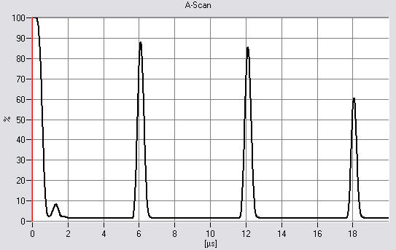
Ultrasonic Principles
A-Scan Presentation
The distance that a soundbeam travels to a reflecting surface can be measured and displayed on a screen.

Slide 18
Ultrasonic Principles
Soundbeam Characteristics
Common ultrasonic test instruments have frequencies available in a range from 500kHz to 25MHz. Soundbeams of all frequencies can penetrate fine-grained material without difficulty. However, when using high frequencies in coarse-grained material, interference in the form of scattering occurs.
This phenomena is used to measure case depth when high-frequency sound waves travelling through the fine-grained case, are scattered at the interface of fine-grained (case) to coarse-grained (base material).
This is referred to the “Back-Scatter” effect.

Slide 19
Ultrasonic Case Depth Measurement
Back-Scatter Effect
The ultrasonic back-scatter technique is used to nondestructively evaluate and measure the case depth (Rht) of heat-treated parts.
This technique allows the detection of the transition between different polycrystalline structures due to their variation in backscattering characteristics. Acoustic backscattering increases with the increase of the particle (grain) size because the ultrasonic dispersion coefficient is proportional to the third power of the effective particle size if the condition “wavelength larger than particle size” is true.

Slide 20
Ultrasonic Case Depth Measurement
Back-Scatter Effect
Induction hardening usually creates a fine-grained, near-surface structure that varies from the unhardened base material structure particularly with regard to particle size.
While the hardened near-surface structure is very transparent to ultrasonic waves, the coarse-grained base material structure exhibits increased ultrasonic backscattering, which results in usable signal amplitudes suitable for display.

Slide 21
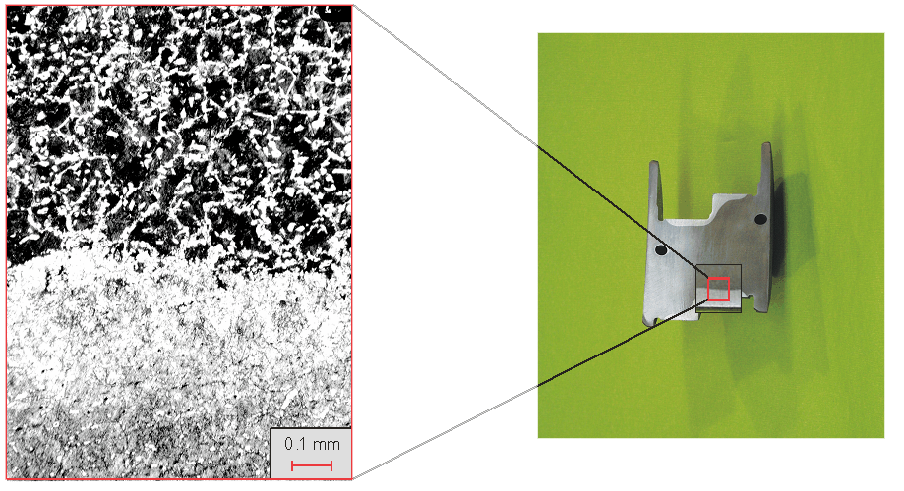
Ultrasonic Case Depth Measurement
Back-Scatter Effect
Micro-Structure Case Pattern

Slide 22
Ultrasonic Case Depth Measurement
Back-Scatter Effect
Transducer
Case
Case Depth
Base Material

Slide 23
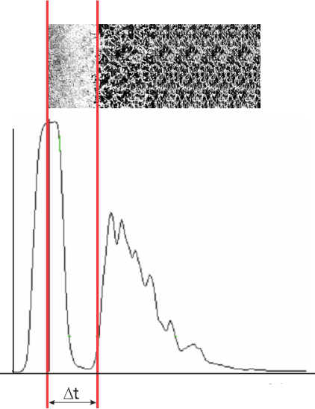
Ultrasonic Case Depth Measurement
Measurement Technique
Case Depth

Slide 24
Ultrasonic Case Depth Measurement
Measurement Technique
The case depth is measured by evaluating the transit time of the ultrasonic pulse when entering the material surface to the case-to-base material interface. The case depth (Rht) is computed without additional calibrations using the given sound velocity of carbon steel and the angle of incidence with the following equation:
Where:
ν = Sound velocity of carbon steel
t = Transit time from entry surface to the base material interface
ß = Angle of incidence in the case material

Slide 25
Ultrasonic Case Depth Measurement
Measurement Technique
A sharp hardness gradient in the transition area provides excellent ultrasonic data that agree very well with the Rht values determined by destructive methods (e.g., Vickers micro-hardness testing).
The ultrasonic back-scatter technique is applicable for case depths of 1.0mm (0.040”) and greater, and can be used to measure the case depth of simple and complex contoured parts, e.g., fillets and radii. The reproducibility of the ultrasonic case depth data is typically within +5% of the case depth.

Slide 26
Ultrasonic Case Depth Measurement
Measurement Technique
As back-scattered ultrasonic signals have a distinct interference structure (due to the phase-sensitive measurement), it is necessary to average the received signal values for increased measurement accuracy.
More accurate results are obtained through “local averaging”, where the specimen is turned in a pre-determined angular range. During the rotation, each backscattered signal is summarized and then averaged. Alternatively, the search unit may be moved with slight forward/backward movements in the desired test location to receive a smooth averaged A-Scan. The “quiver” movement area can be as small as 1.0mm (0.040”) to achieve accurate test results.

Slide 27
Ultrasonic Test Instrument
Industrial PC
The standard PC-based test system consists of the following main components:
Ruggedized rack-mount PC
Intel® Core™ 2 Duo E8400 LGA775, 3.0 GHz CPU, 4GB RAM
500GB & 1TB HDD and a LightScribe DVD/CD-RW drive
22” Touch Screen monitor, keyboard and touch pad
Standard PC ports, RS-232, LPT, PS/2, USB 2.0, etc.
BNT RF cable connectors (male)

Slide 28
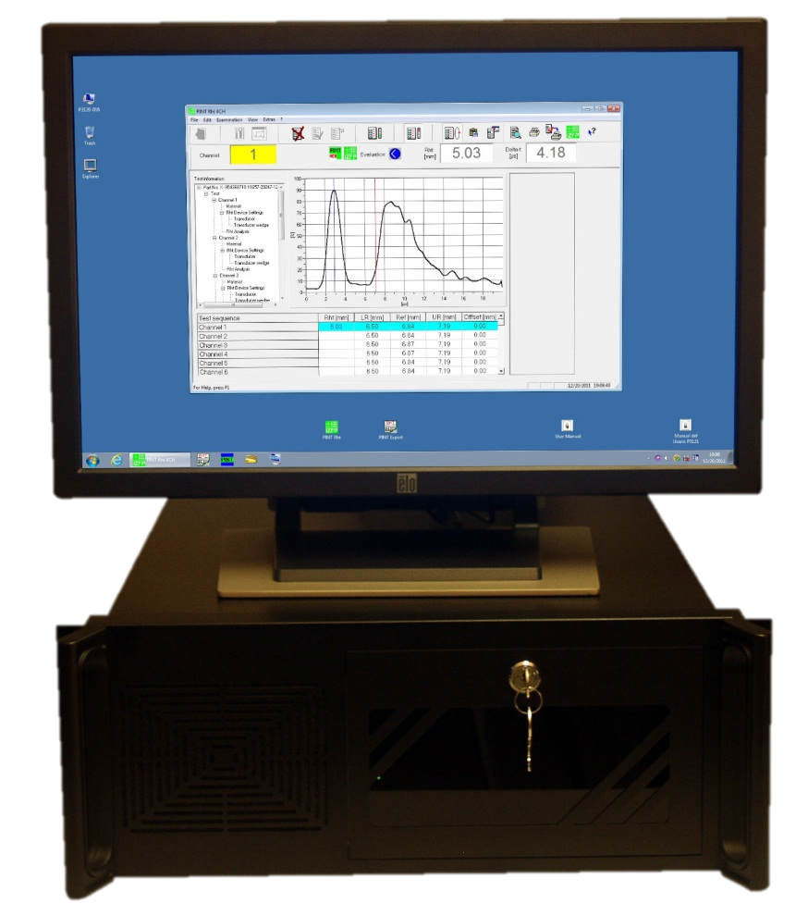
Ultrasonic Test Instrument
Industrial PC

Slide 29
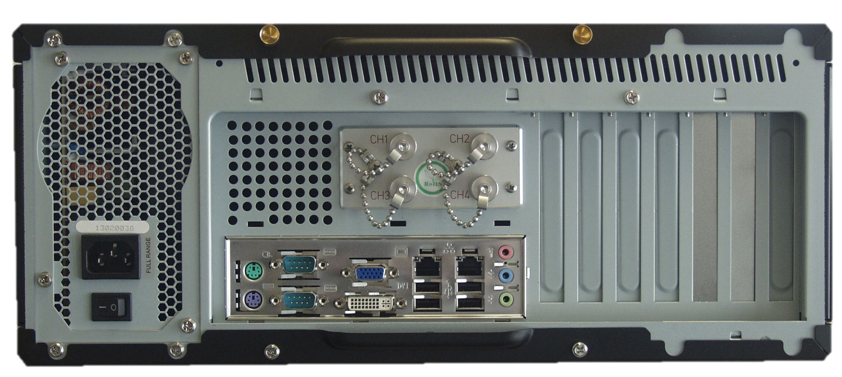
Ultrasonic Test Instrument
Industrial PC
RF Cable Connectors, 4 Channel System

Slide 30
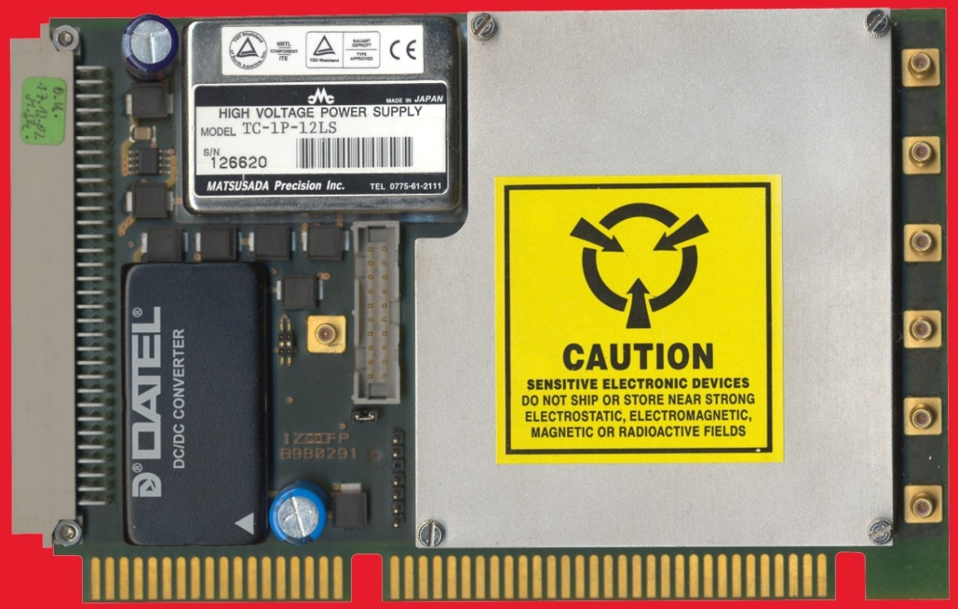
Ultrasonic Test Instrument
Ultrasonic Components
Pulser/Receiver Board – Transmits and Receives UT (analog) Data

Slide 31
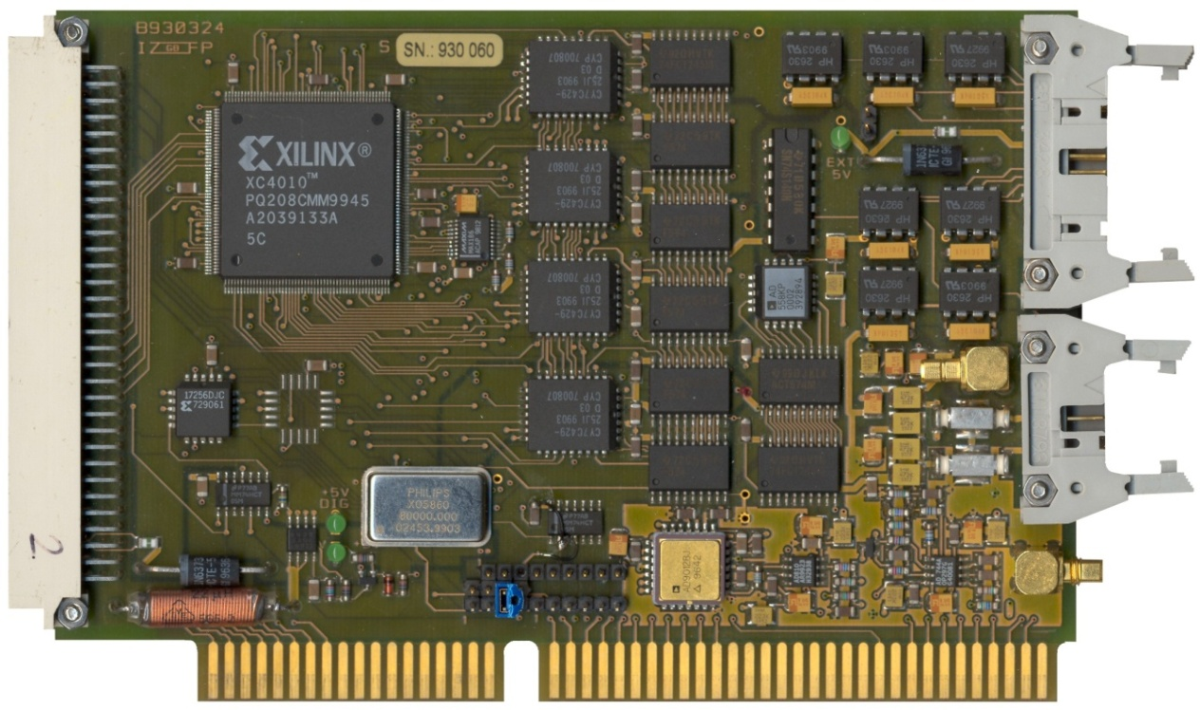
Ultrasonic Test Instrument
Ultrasonic Components
A/D Board – Converts UT (analog) Data to Digital Data

Slide 32
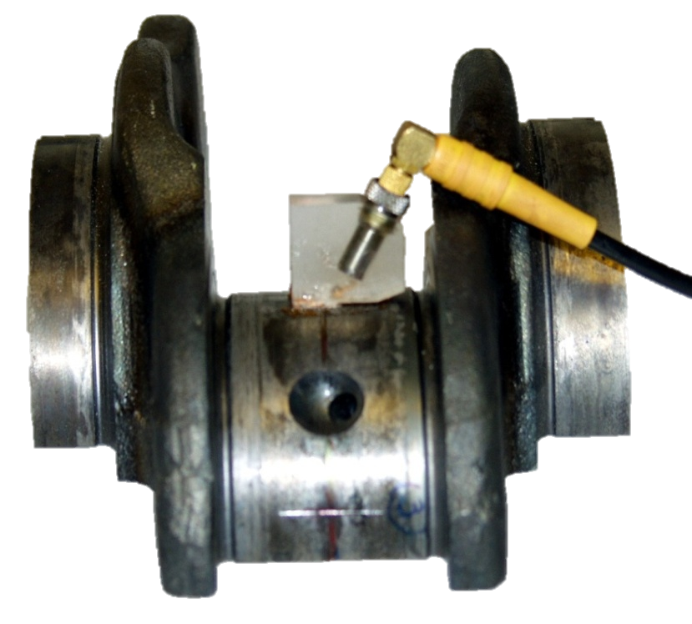
Ultrasonic Test Instrument
Ultrasonic Components
Standard Ultrasonic Transducers

Slide 33
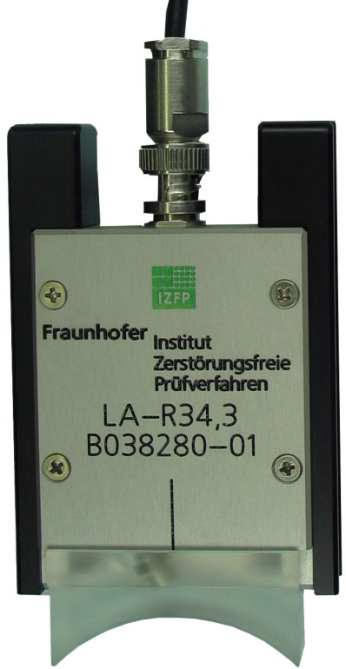
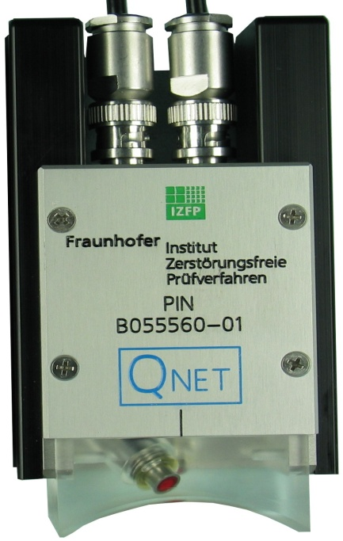
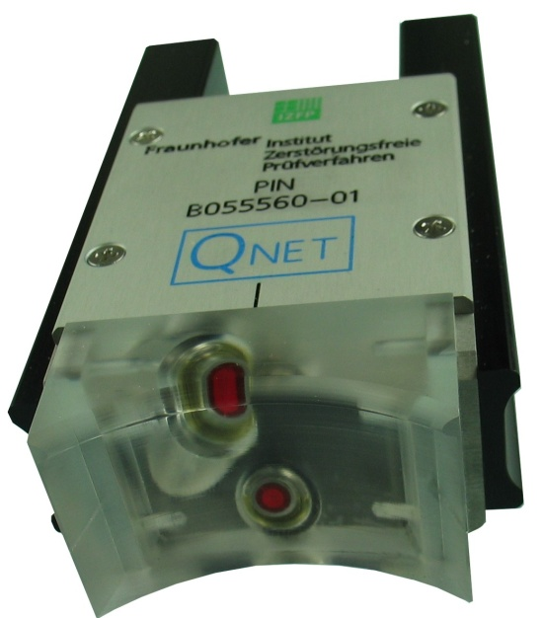
Ultrasonic Test Instrument
Ultrasonic Components
Fitted Ultrasonic Search Unit

Slide 34
Ultrasonic Test Instrument
Safety Information
The P31-Series test instrument was designed and built in accordance with national and international standards and specifications. The instrument complies with the requirements of the relevant CE specification, certified by the CE Compliance document (ISO-9000) and by the CE Mark.
Chapter A.3 of the User Manual provides General Safety Information in more detail.

Slide 35
Testing Software
General
Ultrasonic case depth testing is completely software driven. The current version (3.06.a) runs under Windows® 7 Professional.
The software consists of several individual modules for setup, testing and documentation:
Master Records, including all relevant test setup variables
Databases for instrument settings, analysis settings, transducers, wedges, materials, drawing numbers, inventory numbers and inspection personnel
Various test modes, including Basic Mode, Standard Mode, Enhanced Mode and Calibration Mode
Form generator for custom-designed inspection reports

Slide 36
Testing Software
Master Record
The Master Record contains all parameters required by the instrument to collect ultrasonic data and relevant database information to generate inspection reports.
Setup parameters for the ultrasonic hardware, such as gain settings, data mode, pulse repetition rate (PRR), filter settings, transmitter voltage, etc., are available as a default dataset in the Rht Device Settings database. Setup parameters for the evaluation software module, such as S/N Ratio, Evaluation Level, Averaging settings, etc. are available as a default dataset in the Rht Analysis module. These settings can be adjusted to accommodate individual testing requirements.

Slide 37

Testing Software
Master Record
Once a Master Record has been built and saved to the database, it cannot be revised or modified. This measure assures the integrity of previously performed case depth inspections.
To revise or modify a Master Record, the Master Record to be revised can be duplicated (copied), modified and then saved under a new or revised name.
The Master Records database program is accessed by double-clicking the PINT Base shortcut from the Start Menu, Rht 4CH.
PINT Base

Slide 38
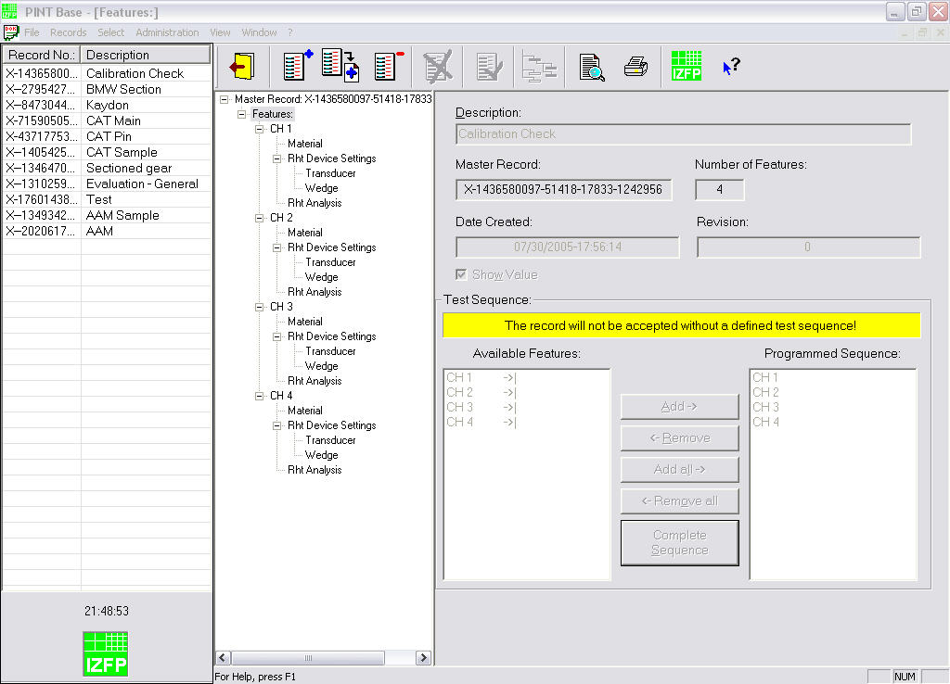
Testing Software
Master Records – Features

Slide 39
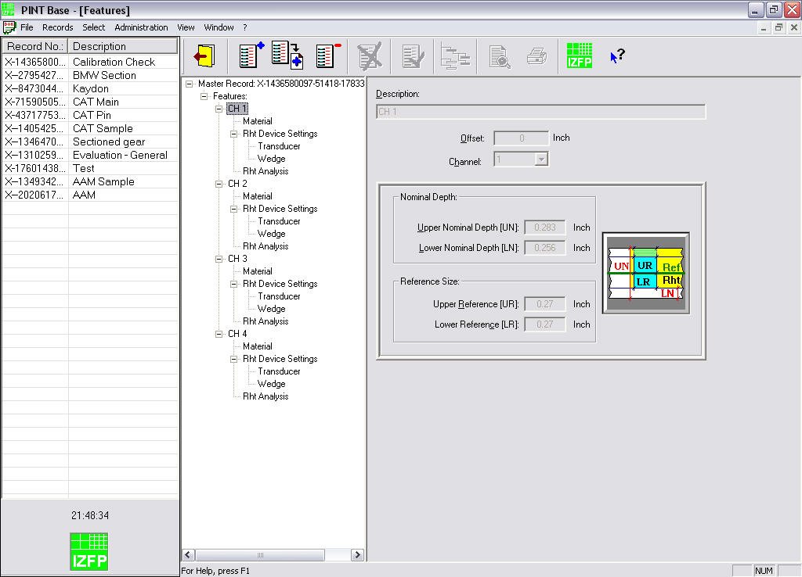
Testing Software
Master Records – Feature information

Slide 40
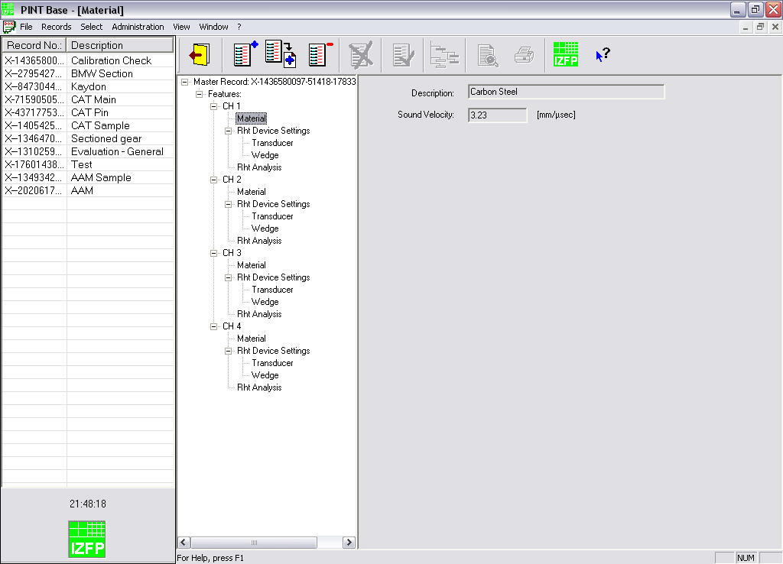
Testing Software
Master Records – Feature 1, Material

Slide 41
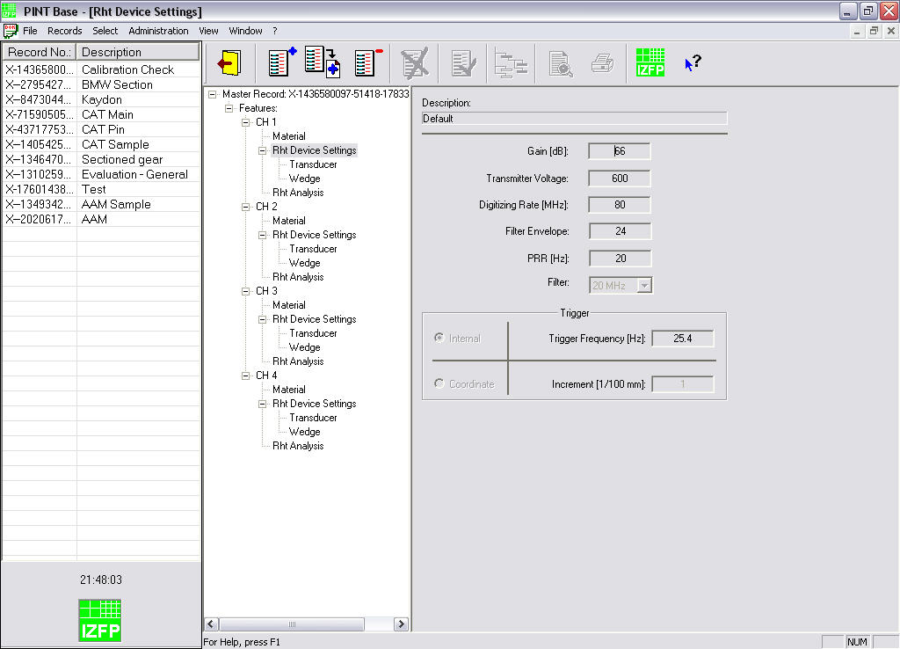
Testing Software
Master Records – Feature 1, Device Settings

Slide 42
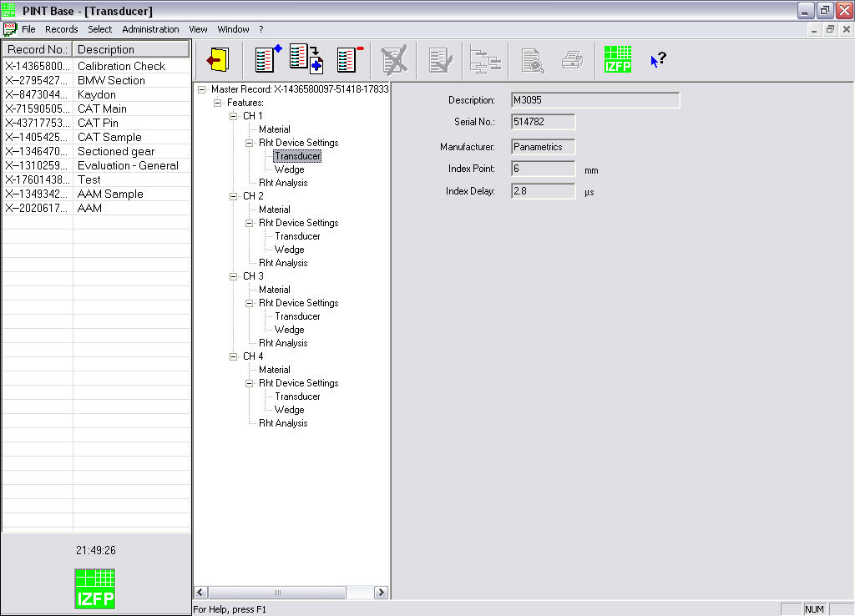
Testing Software
Master Records – Feature 1, Transducer

Slide 43
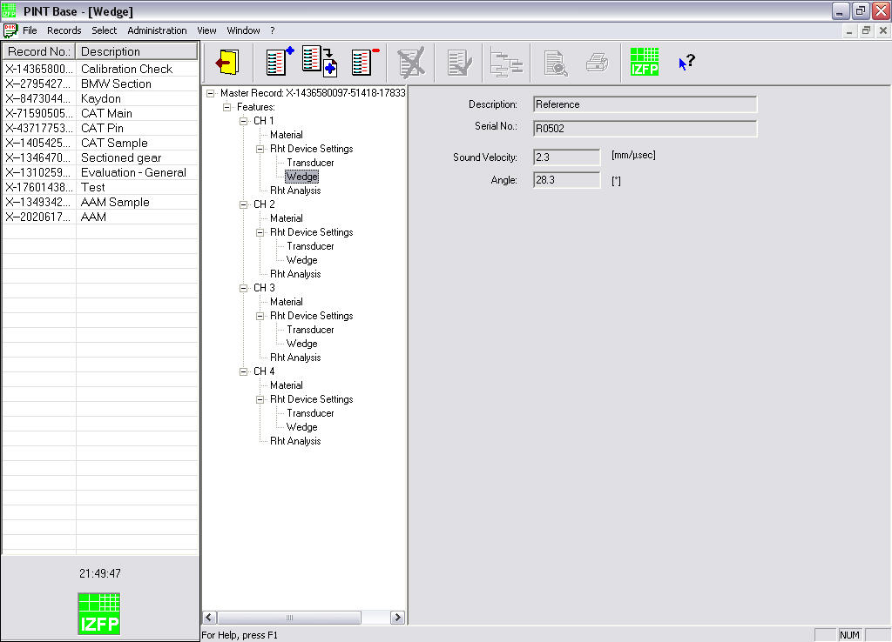
Testing Software
Master Records – Feature 1, Wedge

Slide 44
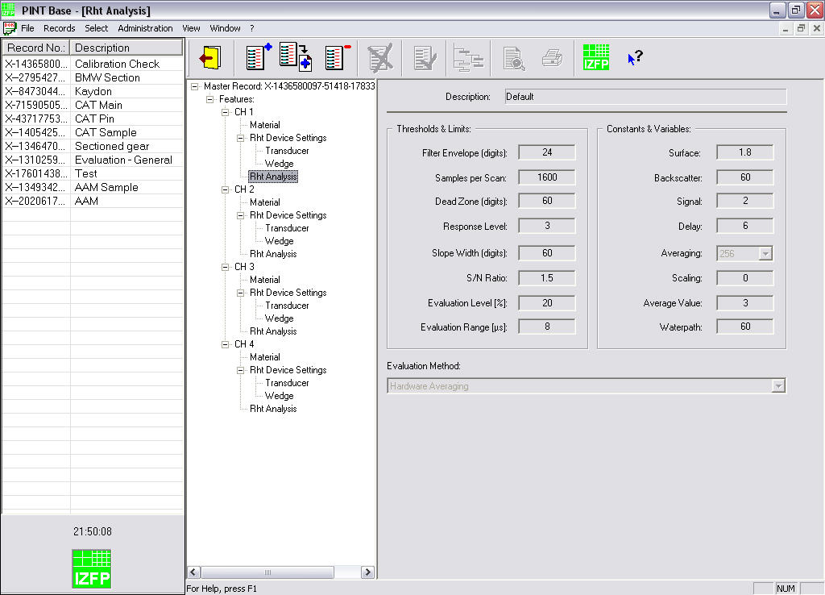
Testing Software
Master Records – Feature 1, Analysis Settings

Slide 45
Testing Software
PINT Database
The program provides several databases for instrument settings, analysis settings, transducers, wedges, materials, drawing numbers, inventory numbers and inspection personnel.
Individual databases are accessed by double-clicking the shortcuts from the Start Menu, Rht 4CH, Database:
Analysis Settings
Device Settings
Drawings (Part No.)
Inspectors (Operators)
Inventory (Line No.)
Materials
Transducers
Wedges

Slide 46
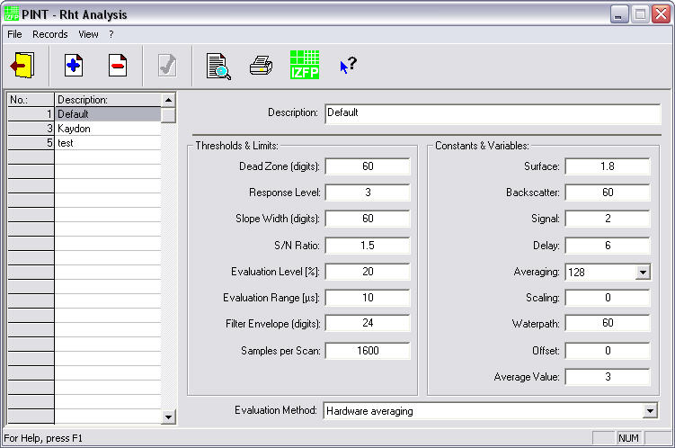
Testing Software
Database – Analysis Settings
This database contains setup parameters such as Signal to Noise (S/N) Ratio, Evaluation Level and Range, Filter Envelope, Averaging Sample settings, etc., to control the data evaluation settings.

Slide 47
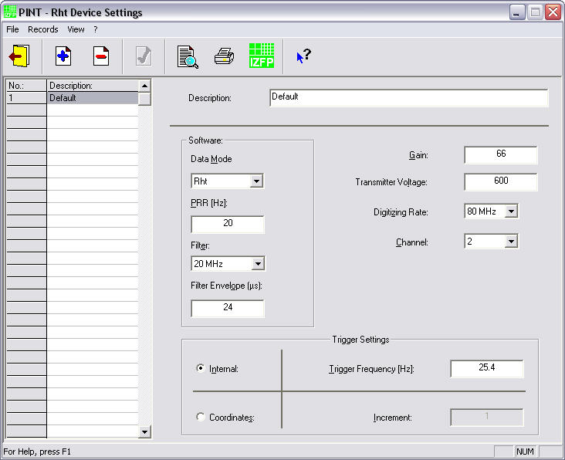
Testing Software
Database – Device Settings
This database contains setup parameters such as Data Mode, Pulse Repetition Rate (PRR), Filter Settings, Transmitter Voltage, Digitizing Rate, Channel and Trigger Settings to control the ultrasonic pulser/receiver.

Slide 48
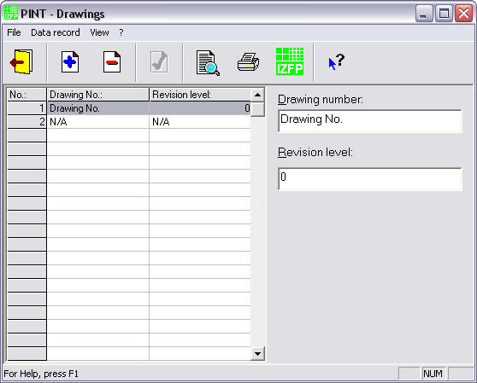
Testing Software
Database – Drawings (Part Numbers)
This database contains the listing for available drawing or part numbers. This information is not required for data acquisition or analysis and is provided for documentation purposes only.

Slide 49
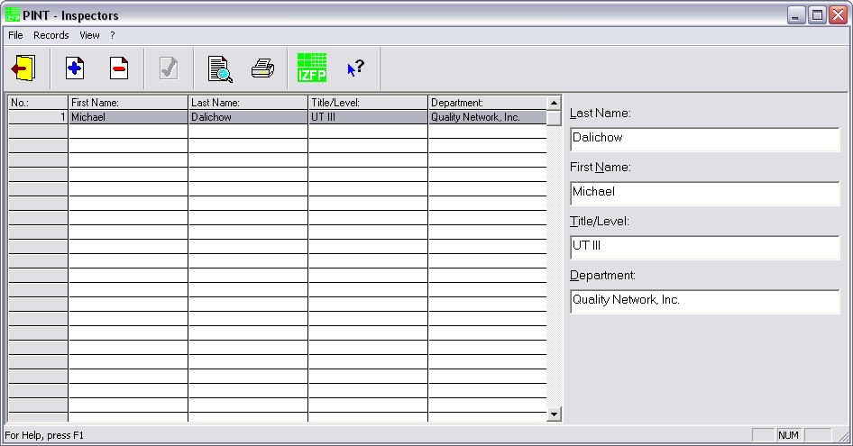
Testing Software
Database – Inspectors (Operators)
This database contains information on the inspection personnel, including first and last name, title/level and department. This information is not required for data acquisition or analysis and is provided for documentation purposes only.

Slide 50
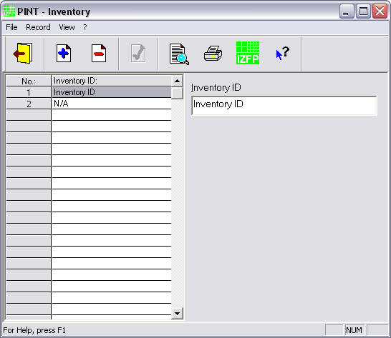
Testing Software
Database – Inventory ( Line No.)
This database contains the listing for parts inventory or line numbers. This information is not required for data acquisition or analysis and is provided for documentation purposes only.

Slide 51
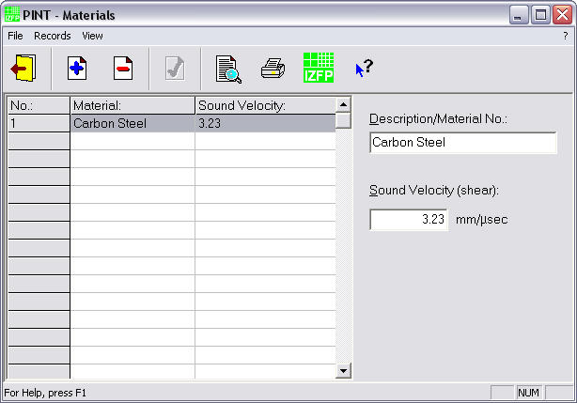
Testing Software
Database – Materials
This database contains the listing for different materials. The sound velocity of the material entered here is required to control the data evaluation settings.

Slide 52
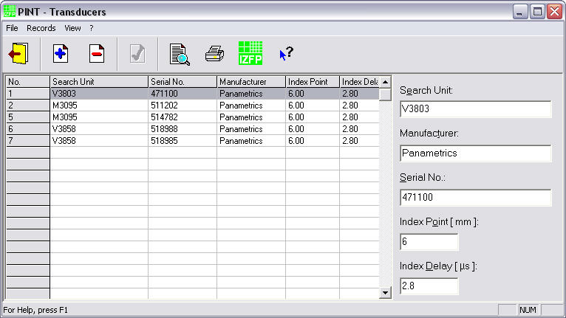
Testing Software
Database – Transducers
This database contains the listing for available transducers, including Name or Type, Manufacturer and Serial Number. Index Point and Index Delay settings, which are required by the data analysis program, are also listed.

Slide 53
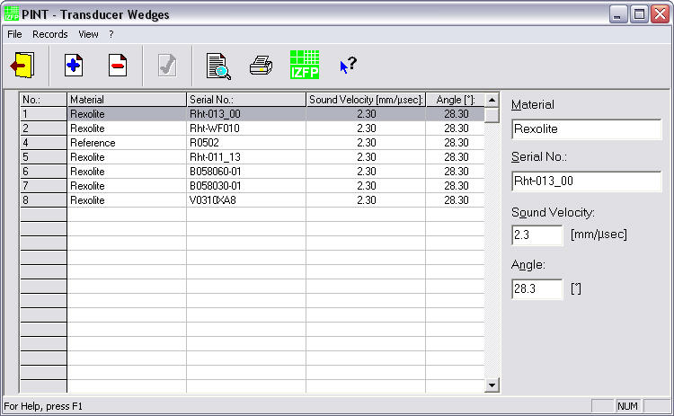
Testing Software
Database – Wedges
This database contains the listing for available transducer wedges, including Material and Serial Number. Sound Velocity and Angle settings required by the data analysis program, are also listed.

Slide 54

Testing Software
Software Settings
The PINT Rht Settings control applet permits the administration of various default settings to control data acquisition and analysis displays.
Access to the control applet is password protected and is usually reserved for the system administrator or supervisor.
The program is accessed by double-clicking the Rht Settings icon on the screen or from the Windows Control Panel.
Rht Settings

Slide 55
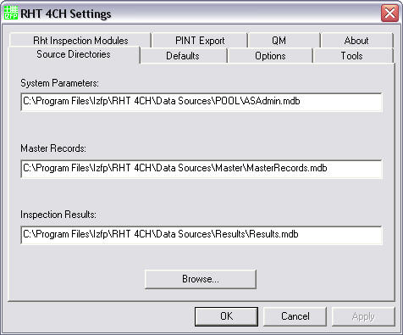
Testing Software
Rht 4CH Settings – Source Directories
The Source Directories Tab permits the selection of System Parameters, Master Records and Results data base directories.

Slide 56
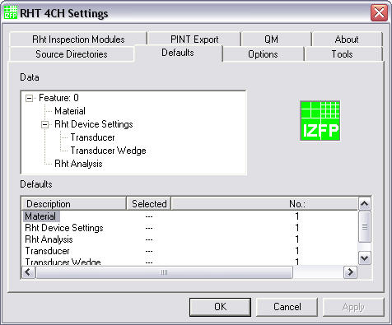
Testing Software
Rht 4CH Settings – Defaults
The Defaults Tab permits the selection of defaults settings for new Master Records.

Slide 57
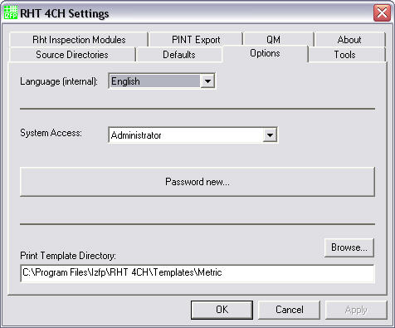
Testing Software
Rht 4CH Settings – Options
The Options Tab allows the modification of preset passwords and the selection of the Report Template directory.

Slide 58
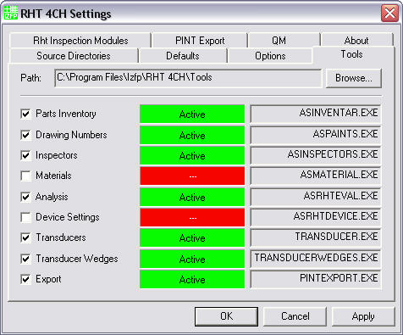
Testing Software
Rht 4CH Settings – Tools
The Tools Tab controls access to the individual databases and the PINT Export module.

Slide 59
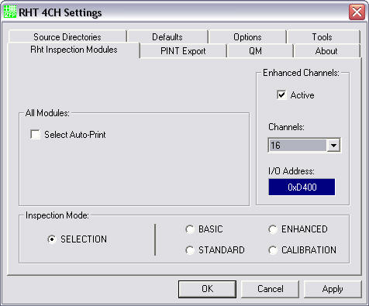
Testing Software
Rht 4CH Settings – Inspection Modules
The Rht Inspection Modules Tab controls the initial Inspection Mode when the PINT Rht program is started. 4-channel or 16-channel hardware settings and Auto-Print functions can also be selected from this Tab.

Slide 60
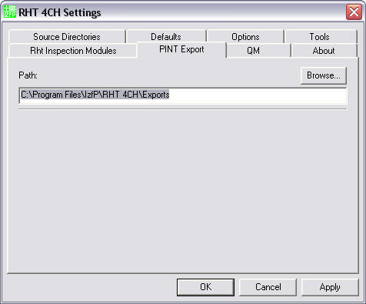
Testing Software
Rht 4CH Settings – PINT Export
The PINT Export Tab allows the selection of the PINT Export directory.

Slide 61
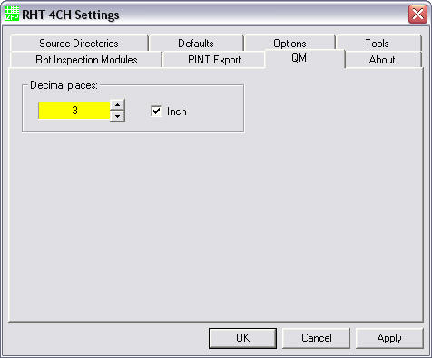
Testing Software
Rht 4CH Settings – QM
The QM Tab allows the user to select the unit (mm or inch) including the number of decimal places to be displayed.

Slide 62
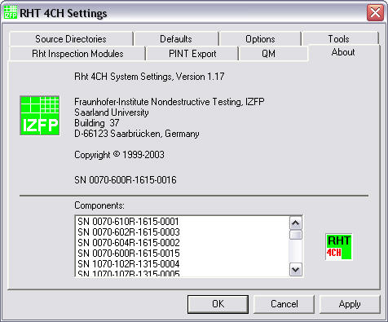
Testing Software
Rht 4CH Settings – About
The About Tab depicts the current revision of the individual software components installed on the inspection system.

Slide 63

Testing Software
PINT Export
The PINT export program allows viewing, editing, exporting and removing of previously stored test data. In addition, the program can be used to reorganize, preview and print test reports that were previously recorded.
The program is accessed by double-clicking the PINT Export icon on the screen or the Start Menu, Rht 4CH PINT Export shortcut.
PINT Export

Slide 64
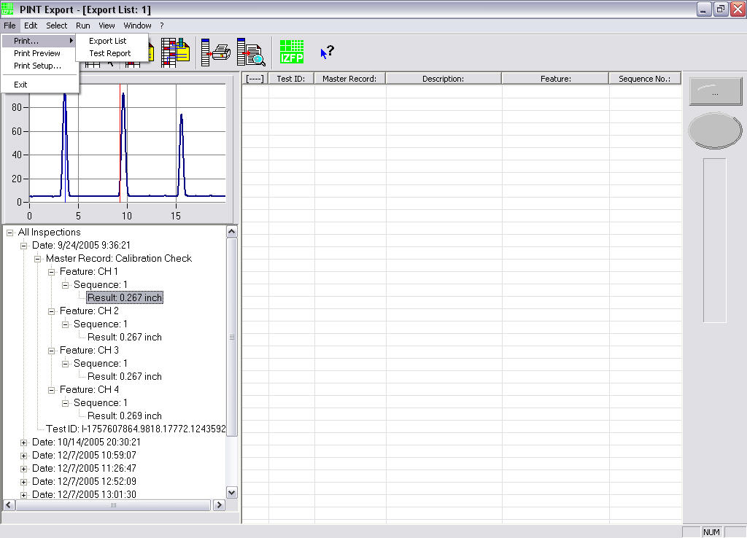
Testing Software
PINT Export – File Menu
The File Menu provides access to the print menu and allows Printer Setup, Print Preview and Printing of existing test reports and export files.

Slide 65
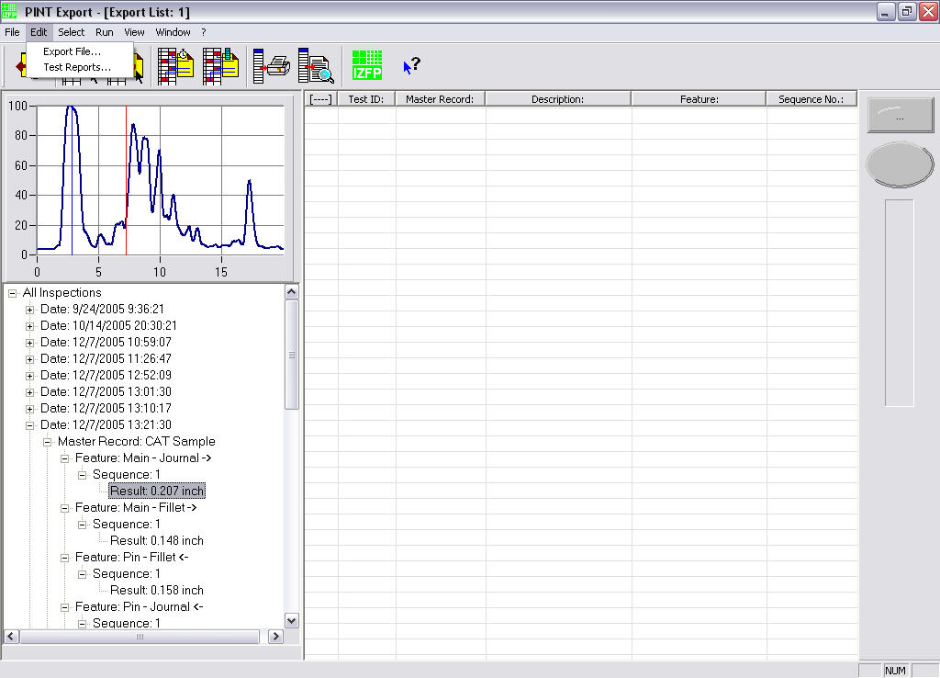
Testing Software
PINT Export – Edit Menu
The Edit Menu permits viewing of exported files and customization of test report print templates.

Slide 66
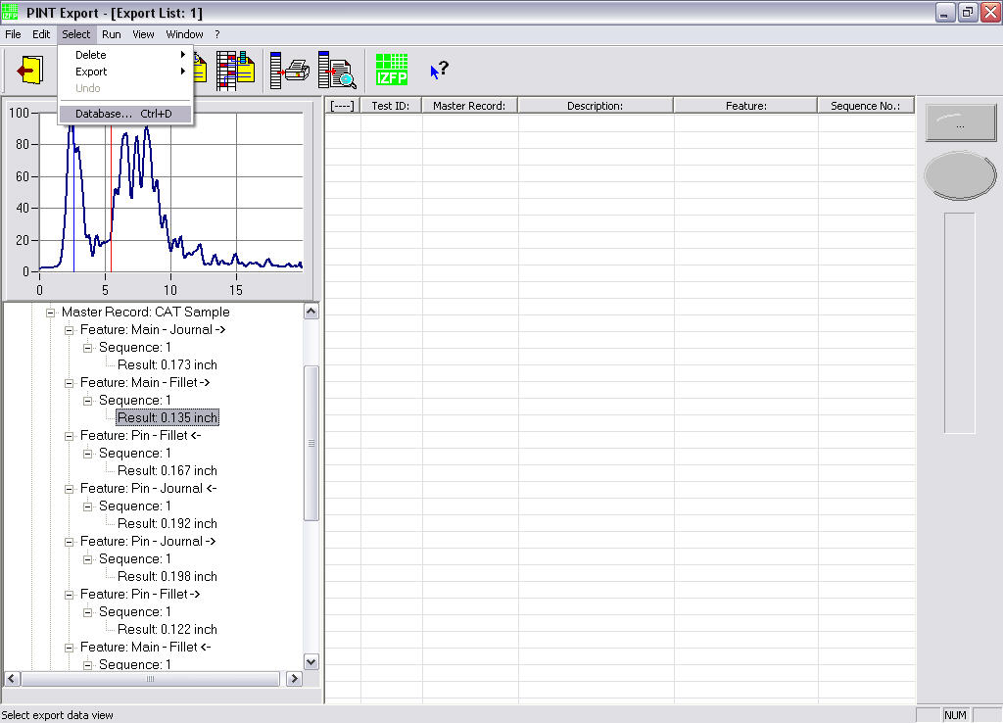
Testing Software
PINT Export – Select Menu, Database
The Select Menu provides for the display selection of Test Data or Reference Data by clicking the Database command or  + .

Slide 67
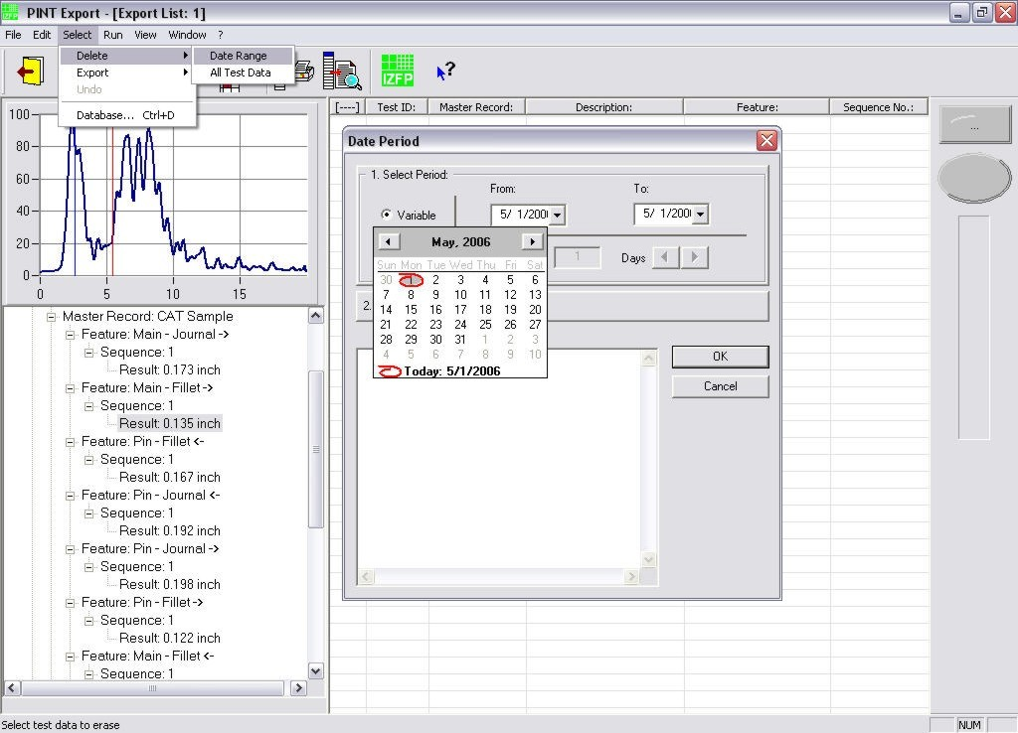
Testing Software
PINT Export – Select Menu, Delete (Export) Records by Date Range
To delete or export records from the selected database based on a date range, the appropriate dates from the “from” and “to” drop-down menus are chosen.

Slide 68
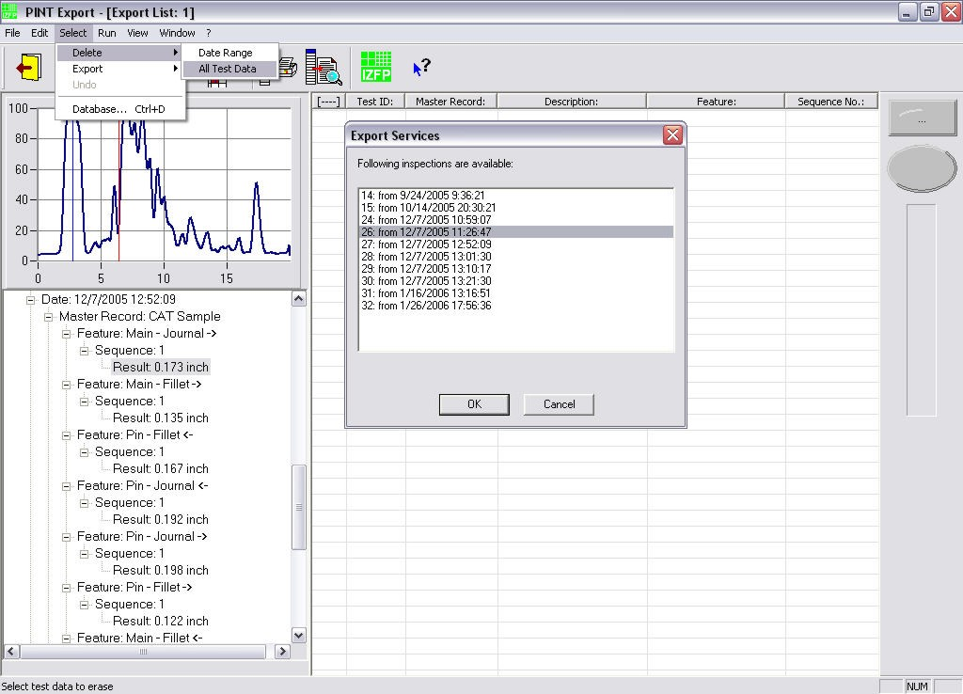
Testing Software
PINT Export – Select Menu, Delete (Export) Records by Date Range…
To delete or export any or all records from the selected database, select from the “All Test Data” drop-down list for deletion.

Slide 69
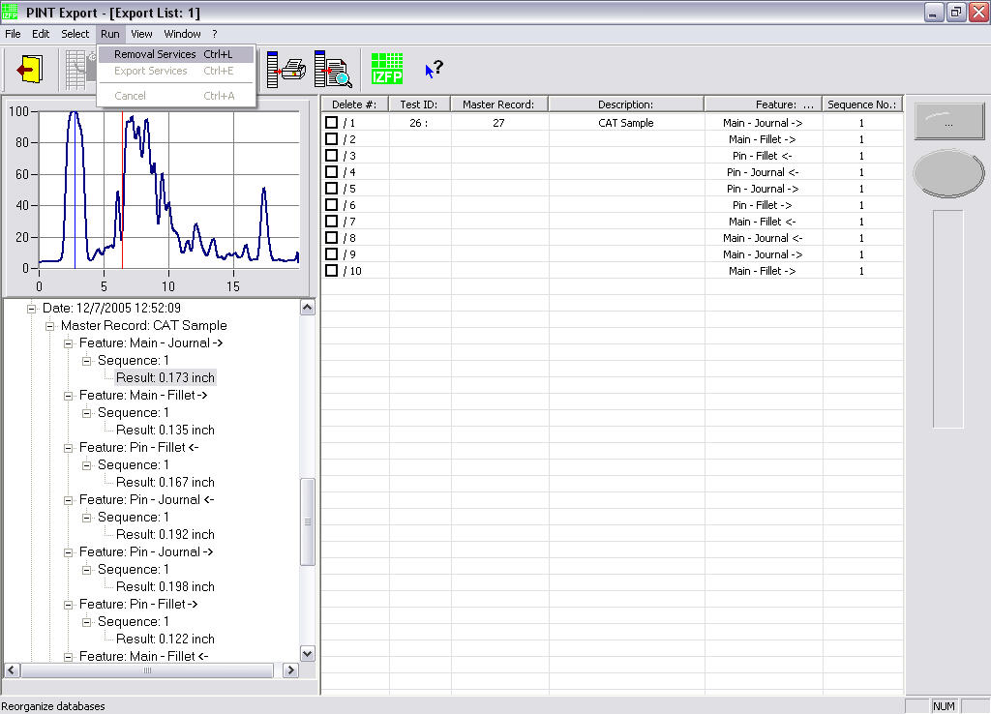
Testing Software
PINT Export – Select Menu, Delete Records…
After records have been selected for deletion or exporting, Test ID, Master Record number and Description are displayed. The selected records can now be processed from the Run Menu, Removal Service or Export Service.

Slide 70
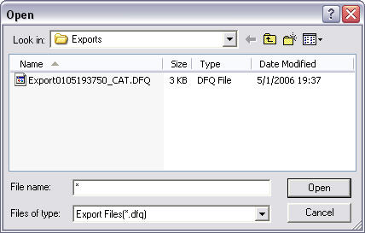
Testing Software
PINT Export – Select Menu, Exporting Records
Test records are processed into DQF format files and are saved in the default directory or as assigned by the user (see Rht 4CH Settings – PINT Export). The program automatically assigns file names to the exported file as follows:
Export0105193750_CAT.DQF File Name
0105: 01.05. (day, 1. of May)
193750: 19:37:50 (time, 7:37:50 PM)
CAT: Master Record Description

Slide 71
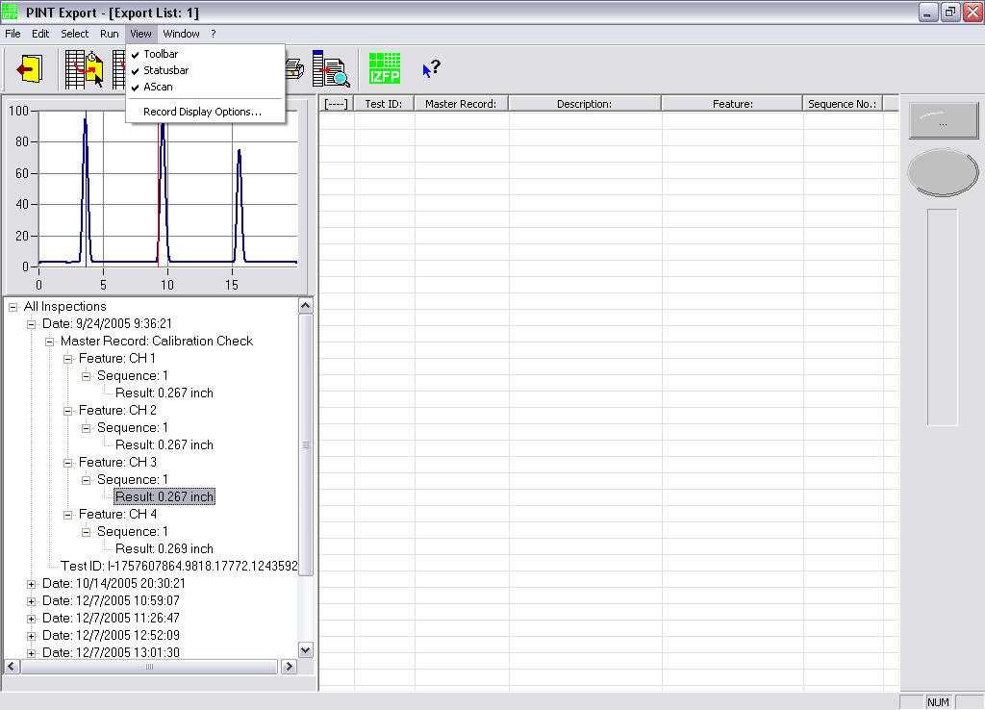
Testing Software
PINT Export – View Menu
The View Menu allows the user to toggle the display of the Toolbar, Status bar and A-Scan display of the selected database files.

Slide 72
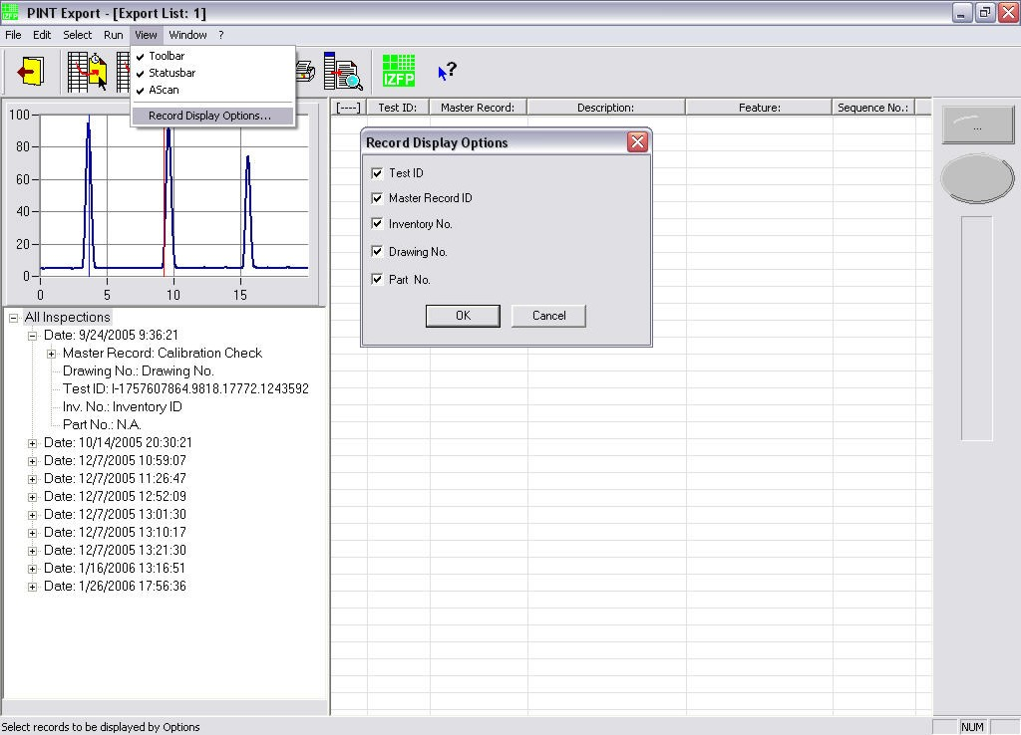
Testing Software
PINT Export – View Menu, Display Options
The Display Options command allows the user to select any or all of the record identifiers, e.g. Test ID, Master Record ID, Inventory Number, Drawing Number and Part Number to be displayed in the left Menu pane.

Slide 73
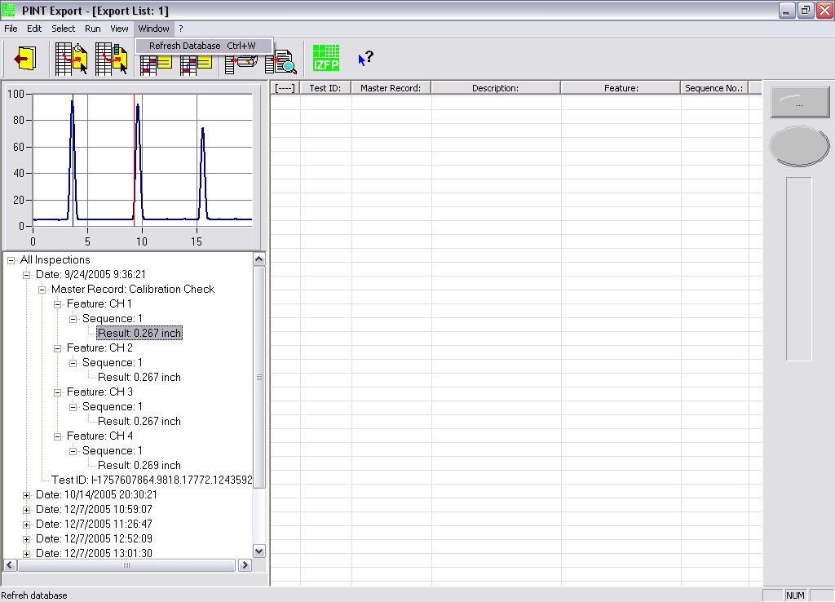
Testing Software
PINT Export – Window Tab
The Window Tab (+) permits the user to refresh the current display. No other functions are associated with this command.

Slide 74
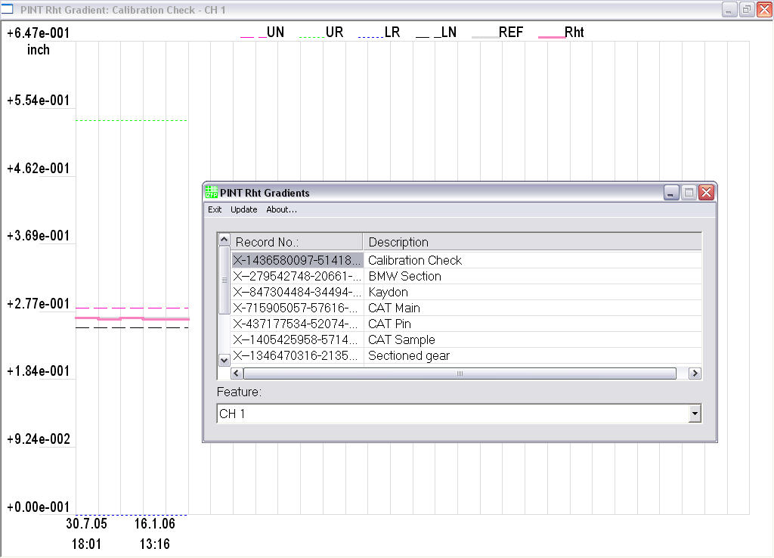
Testing Software
Tools – Rht Explorer
The Rht Explorer program provides a graphical display of up to 30 test readings of a selected feature. The program is accessed by selecting the Rht Explorer shortcut from Start, Rht 4CH, Tools.

Slide 75
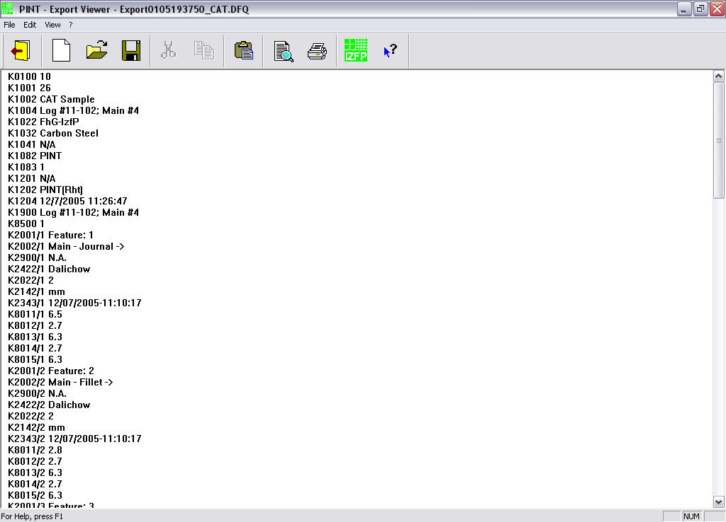
Testing Software
Tools – PINT Export Viewer
The PINT Export Viewer provides a listing of relevant test data of all saved inspections. The program is accessed by selecting the Export Viewer shortcut from Start, Rht 4CH, Tools.

Slide 76
Test Preparations
Test Equipment
The PC-based P31-Series case depth testing system is, as the name implies, primarily a test instrument. The system incorporates an advanced ultrasonic data acquisition and analysis software package built on the convenience of the Windows® 7 platform. The system’s functionality has been thoroughly tested in the configuration in which it was delivered.
Any software/hardware alterations and/or additions may corrupt the test system configuration. It is strongly suggested that the user backup the entire system, including system state data, prior to installing any additional software and/or hardware.

Slide 77
Test Preparations
Test Equipment
It is strongly recommended that the entire User Manual be read prior to using the test instrument. The User Manual should always be readily accessible and available for reference.
The instructions and information contained in the User Manual help to assure:
Correct operation of the test instrument
Efficient use of the testing system
Accurate test results
Avoidance of system breakdown and production outage
Avoidance of injuries during system operation

Slide 78
Test Preparations
Test Equipment
Prior to power-up of the test system, it is recommended that all cables, e.g. power cables, monitor cables, RF cables (at the PC and at the search unit), etc., be checked for proper connection.
After power-up of the computer system and user logon, sufficient time should be allowed for the system to perform internal boot-sequences and stabilization.
When the hard disk indicator light stops blinking the system is ready for the PINT programs to commence.
To avoid short-circuit damage to the pulser/receiver board, never connect or disconnect RF cables from the transducer or the system during data-acquisition; always stop data-collection before changing transducers or cables!

Slide 79
Test Preparations
Test Specimen
The test specimen should be clean and free of paint or loose scale in the inspection areas. Light corrosion should not have any negative impact; however, heavy rust or excessive tool marks may lead to difficulties during data acquisition and analysis.
Finished (polished) test surfaces may also lead to undesirable poor sound transmission due to lack of couplant on the test surface.

Slide 80
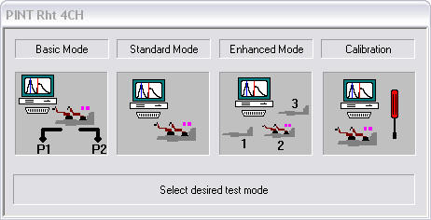
Data Acquisition & Analysis
PINT Rht Test Program
The PINT Rht program is accessed by double-clicking the PINT Rht icon on the screen or selecting the PINT Rht shortcut from the Start Menu.
Upon starting of the PINT Rht program, the system first initializes the program environment and then displays the startup menu. The desired inspection mode can be selected by clicking one of the four Mode buttons. Alternatively, the system administrator can assign a default inspection mode from the PINT System control panel.

Slide 81
Data Acquisition & Analysis
PINT Rht Test Modes
Basic Mode
The Basic Mode permits case depth testing and data display using previously prepared setup data (Master Records) without the capability of permanent storage of the result data to disk. Collected data is temporarily stored to the system memory and can be printed and/or saved to a test report (PDF).
Standard Mode
The Standard Mode permits case depth testing and data display using previously prepared setup data (Master Records) including the capability to save the test results to disk. The collected data can be printed and/or saved to a test report prior to saving the data. Test data collected using this mode can later be reviewed and printed from the PINT Export module.
The Standard Mode is also used to perform reference measurements (required if no test data are available for a given Master Record).

Slide 82
Data Acquisition & Analysis
PINT Rht Test Modes
Enhanced Mode
The Enhanced Mode performs case depth testing and data display similar to the Standard Mode with up to ten data points (sequences) for each selected feature. This mode is primarily used when multiple test locations, with varying test parameters, are required for inspection.
Calibration Mode
The calibration mode is used to perform system calibration and/or system calibration verification. In this mode, all system parameters can be modified online while observing the changes in the A-Scan presentation (screen).

Slide 83
Data Acquisition & Analysis
Reference Measurements
Reference measurements should be taken in regular intervals to assure proper system performance and consistent case depth readings. Reference data are collected in the Standard Mode and must be acquired prior to collecting production case depth data using the Standard and/or Enhanced inspection modes.
It is recommended that reference data are collected from a “Master” sample with a specified (known) case depth for each feature, channel and search unit. Saved reference data provide for a simple way to document the integrity of the entire test system.

Slide 84
Data Acquisition & Analysis
Basic Mode
The Basic Mode permits case depth testing and data display using previously prepared setup data (Master Records) without the capability of permanent storage of the results to disk. Collected data is temporarily stored to the system memory and can be printed and/or saved to a test report (PDF).

Slide 85
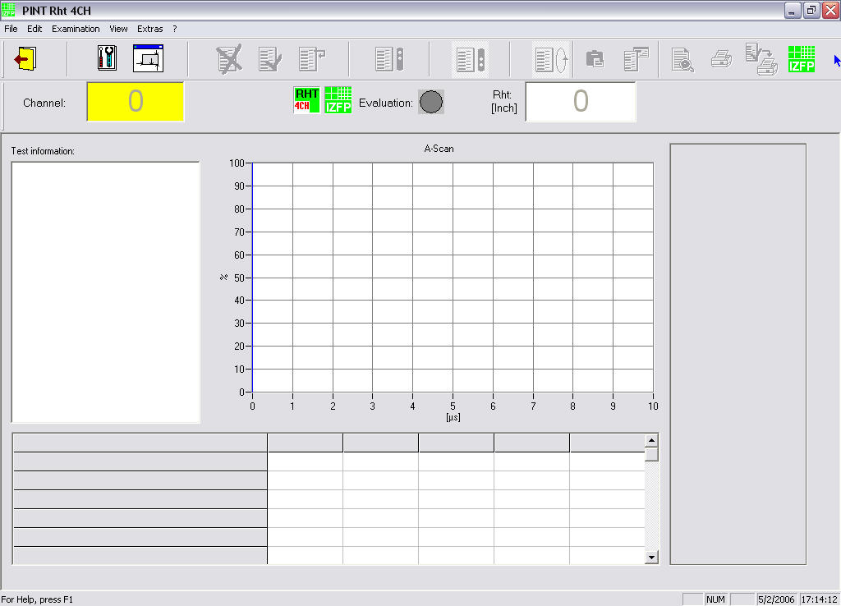
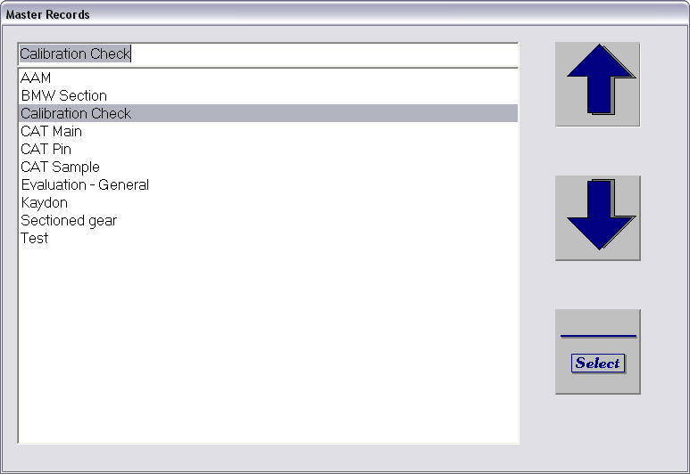
Data Acquisition & Analysis
Basic Mode, Master Record Selection
After selecting Basic Mode the program displays the main window and the user is prompted to enter the test specific information, first the Master Record.

Slide 86
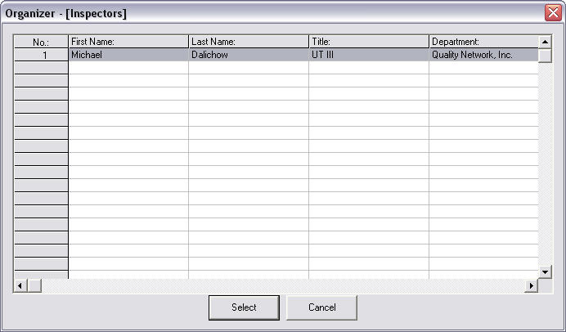
Data Acquisition & Analysis
Basic Mode, Operator Selection
This window allows the selection of the operator (inspectors database) performing the test.

Slide 87

Data Acquisition & Analysis
Basic Mode, Inventory Number Selection
This window allows the selection of the inventory number or line number (inventory database) of the part to be tested.

Slide 88

Data Acquisition & Analysis
Basic Mode, Part (Drawing) Number Selection
This window allows the selection of the part number (drawings database) of the item to be tested.

Slide 89

Data Acquisition & Analysis
Basic Mode, Part ID
This window allows the user to enter the Part ID (free text) of the item to be inspected.

Slide 90

Data Acquisition & Analysis
Basic Mode, Control Buttons
The main window appears and shows the control buttons above the channel indicator, evaluation indicator and the case depth readout.

Slide 91



Data Acquisition & Analysis
Basic Mode, Control Buttons
Start button or  starts data collection for the selected feature
Stop button or  ends data collection for the selected feature
Next button or  accepts current data and proceeds to next feature
Mode button or  toggles continuous/single shot mode
Preview button or  displays the test report
Print button or + prints the test report to the selected printer

Slide 92


Data Acquisition & Analysis
Basic Mode, Start Data Collection
To start the inspection, a sufficient amount of couplant is placed onto the test surface and the search unit is positioned onto the sample. Clicking on the Start button (or ) starts ultrasonic data acquisition.

Slide 93

Data Acquisition & Analysis
Basic Mode, Stop Data Collection
Data acquisition is stopped by clicking the Stop button or the  key. The data for the current feature is temporarily stored and displayed in the table below the A-Scan. Test data can be overwritten until the next feature is selected.

Slide 94


Data Acquisition & Analysis
Basic Mode, Next Feature
The next feature is selected by clicking the Next button or the  key. The Next Feature is highlighted and the program is ready to acquire data of the current feature.

Slide 95


Data Acquisition & Analysis
Basic Mode, Complete
After collecting data for all features, the Next button or the  key is selected to complete data acquisition and the test data can now be printed. Note: Test data cannot be saved in the Basic Mode!

Slide 96
Data Acquisition & Analysis
Standard Mode
The Standard Mode permits case depth testing and data display using previously prepared setup data (Master Records) including the capability to save the results to disk.
The collected data can be printed and/or saved to a test report prior to saving the data. Test data collected using this mode can later be reviewed and printed from the PINT Export module.
The Standard Mode is also utilized to perform reference measurements (required if no test data are available for a given Master Record).

Slide 97
Data Acquisition & Analysis
Standard Mode, Master Record Selection
After selecting the Standard Mode the program displays the main window and the user is prompted to enter the Master Record.

Slide 98
Data Acquisition & Analysis
Standard Mode, Operator Selection
This window allows the selection of the operator (from inspector database) performing the test.

Slide 99
Data Acquisition & Analysis
Standard Mode, Inventory Number Selection
This window allows the selection of the inventory number (from inventory database) of the part to be tested.

Slide 100
Data Acquisition & Analysis
Standard Mode, Part (Drawing) Number Selection
This window allows the selection of the part number (from drawing database) of the item to be tested.

Slide 101
Data Acquisition & Analysis
Standard Mode, Part ID
This window allows the user to enter the Part ID (free text) of the item to be inspected.

Slide 102

Data Acquisition & Analysis
Standard Mode, Reference Query
The program asks the user if a reference measurement should be performed; “Yes” records all data as reference data, “No” records all data as standard test data.

Slide 103
Data Acquisition & Analysis
Standard Mode, Start
To start the inspection, a sufficient amount of couplant is placed onto the test surface and the search unit is positioned onto the sample. Clicking on the Start button (or ) starts ultrasonic data acquisition.

Slide 104
Data Acquisition & Analysis
Standard Mode, Stop
Data acquisition is stopped by clicking the Stop button or the  key. The data for the current feature is temporarily stored and displayed in the table below the A-Scan. Test data can be overwritten until the next feature is selected.

Slide 105
Data Acquisition & Analysis
Standard Mode, Next
The next feature is selected by clicking the Next button or the  key. The Next Feature is highlighted and the program is ready to acquire data of the current feature.

Slide 106



Data Acquisition & Analysis
Standard Mode, Save Data
After collecting data for all features, the Next button or the  key is selected to complete data acquisition. Test data can now be discarded, previewed, printed or saved by clicking the button, followed by the confirmation window.

Slide 107


Data Acquisition & Analysis
Standard Mode, Save Data
The test data are now saved to the Records database and confirmed by the PINT Rht program.

Slide 108



Data Acquisition & Analysis
Standard Mode, Additional Control Buttons
Reject button or + rejects test data and returns to main window
Accept button or + accepts and saves all test data
Feature Comments or + adds a comment to the current feature
Test Comment or + adds a comment to the current inspection
Print button or + prints the test report to the selected printer
Auto-Print or  prints the test report after all data are saved

Slide 109
Data Acquisition & Analysis
Enhanced Mode
The Enhanced Mode performs case depth testing and data display similar to the Standard Mode with a maximum of ten data points (sequences) for each selected feature.
This mode is primarily used when multiple test locations, with varying test parameters, are required for inspection.

Slide 110

Data Acquisition & Analysis
Enhanced Mode, Master Record Selection
After selecting the Enhanced Mode the program displays the main window and the user is prompted to enter the Master Record.

Slide 111
Data Acquisition & Analysis
Enhanced Mode, Operator Selection
This window allows the selection of the operator (from inspector database) performing the test.

Slide 112
Data Acquisition & Analysis
Enhanced Mode, Inventory Number Selection
This window allows the selection of the inventory number (from inventory database) of the part to be tested.

Slide 113
Data Acquisition & Analysis
Enhanced Mode, Part (Drawing) Number Selection
This window allows the selection of the part number (from drawing database) of the item to be tested.

Slide 114
Data Acquisition & Analysis
Enhanced Mode, Part ID
This window allows the user to enter the Part ID (free text) of the item to be inspected.

Slide 115

Data Acquisition & Analysis
Enhanced Mode, Number of Sequences
This window allows the user to enter the number of test sequences (maximum of 10) for the item to be inspected.

Slide 116

Data Acquisition & Analysis
Enhanced Mode, Start
The system is now ready to collect data (Start button) in the Enhanced Mode in a similar way as in the Standard Mode with the selected number of sequences for each feature.

Slide 117


Data Acquisition & Analysis
Enhanced Mode, Sequence Complete
After all data for the first sequence have been collected and the Next button (or  key) is clicked, the program is ready to acquire data for the next (second) sequence, click the OK button to continue.

Slide 118

Data Acquisition & Analysis
Enhanced Mode, Next Sequence
The program has saved all data from Sequence 1 and data collection for Feature 1, Sequence 2 is started by clicking the Start button (or  key).

Slide 119


Data Acquisition & Analysis
Enhanced Mode, Auto-Print
When Auto-Print is selected from the Auto-Print button, the program prints the test report after all sequences are completed. Click “Start” to print or “Cancel” to abort printing.

Slide 120

Data Acquisition & Analysis
Enhanced Mode, Test Report
When printing is selected, the program displays the print progress in the Print window.

Slide 121

Data Acquisition & Analysis
Enhanced Mode, Save Data
Once printing is completed the program automatically saves all test data to the test report database (Records.mdb).

Slide 122
Data Acquisition & Analysis
Enhanced Mode, Options
After all test data have been saved, the program provides three options:
1) perform a new test using the same Inspection Mode (+),
2) perform a new test using a different Inspection Mode (+),
3) exit the program using the Exit button or +.

Slide 123
Data Acquisition & Analysis
Calibration Mode
The calibration mode is used to perform system calibration and/or system adjustments. This mode is primarily used when Device or Analysis settings have to be adjusted.
In the Calibration mode, the settings from a selected database, e.g. gain settings (from the Device database) can be altered online to improve the display and accuracy for case depth readings.
The program functions in the Calibration Mode are identical to the other modes, except for the addition of the adjustment functions
The Calibration Mode does not permit saving of test data and/or settings.

Slide 124


Data Acquisition & Analysis
Calibration Mode, Device Settings
Selecting the Device Settings in the left pane of the Main window provides access to all preset Device settings.

Slide 125
Data Acquisition & Analysis
Calibration Mode, Device Settings - Gain
For this example, the slider in the gain box is moved to the left to reduce the gain by 10dB.

Slide 126

Data Acquisition & Analysis
Calibration Mode, Device Settings – Gain
The slider in the gain box is moved to the left to 56dB, to reduce the backscatter amplitude in the A-Scan presentation by 10dB. Clicking the Apply button applies the change.

Slide 127

Data Acquisition & Analysis
Calibration Mode, Device Settings – Gain
The 10dB decrease of the backscatter amplitude in the A-Scan presentation is clearly visible along with the resulting change in the depth reading. All other values can be changed in the same manner.

Slide 128


Data Acquisition & Analysis
Calibration Mode, Analysis Settings
Selecting the Analysis Settings in the left pane of the Main window provides access to all preset Analysis settings.

Slide 129

Data Acquisition & Analysis
Calibration Mode, Analysis Settings – Evaluation Level
For this example, the Evaluation Level is increased from 20% to 40% of the backscatter amplitude by clicking the ► button of the Evaluation Level box until 40% is displayed.

Slide 130
Data Acquisition & Analysis
Calibration Mode, Analysis Settings – Evaluation Level
With the Evaluation Level at 40%, the Apply button is clicked to apply and observe the changes.

Slide 131

Data Acquisition & Analysis
Calibration Mode, Analysis Settings – Evaluation Level
The Evaluation Level has been increased to 40% of the backscatter amplitude (rising edge/red marker), resulting in a larger case depth value.

Slide 132
Documentation
Data Storage
When case depth testing is performed in the Standard or Enhanced mode, the user has the option to save all acquired test data. By default, test data are saved to the Results.mdb database file located in C:\Program Files\IZFP\RHT 4CH\Data Sources\Results, or as chosen in the PINT Rht Settings control applet, Source Directories settings.
Saved data can be exported to DQF format files in the default directory or as assigned by the user (see Rht 4CH Settings – PINT Export).

Slide 133
Documentation
Test Reports
All test data can be printed or previewed from the Rht Main menu (all inspection modes) by clicking the Print Preview button or from the PINT Export application (Standard and Enhanced modes).
Printer settings are controlled from the Windows® Control Panel. A PDF printer (default) is installed to the test system permitting printing to PDF format files, which can be downloaded onto various types of media, such as memory stick, floppy disk, etc.

Slide 134

Documentation
Test Reports

Slide 135

Documentation
Test Report, Standard Mode
The Standard Mode test report includes the test specific information entered prior to data collection, such as Master Record (Record No.), Reference Test, Operator, Line No., etc., and program assigned information such as File Name, Test Date and Report No.

Slide 136
Documentation
Test Report, Standard Mode
Case depth readings for each feature, including upper (UN) and lower (LN) tolerances and comments as entered by the operator are displayed below the report header.

Slide 137

Documentation
Test Report, Enhanced Mode
In addition to the Standard mode information, the Enhanced mode test report shows the data acquired for each selected test sequence on a separate page.
Case depth readings for all features contained in sequence 1 are displayed on page 1 of the test report.

Slide 138

Documentation
Test Report, Enhanced Mode
Case depth readings for all features contained in sequence 2 are displayed on page 2 of the test report.

Slide 139
Documentation
Data Protection, System Backup
To assure that installed programs, system settings, database entries and saved test data are not lost, it is recommended that the entire system (C-drive) is backed up in regular intervals using the pre-installed Norton GHOST drive imaging program.
It is strongly suggested that the C-drive is backed up prior to installing any third-party software programs to avoid accidental loss or replacement of executable and or setup files vital for the test software.
For more information on setup and running Norton GHOST imaging software please consult the program’s documentation.

Slide 140
Summary
Ultrasonic testing to determine the case depth of axle shafts, shaft fillets and splines can be performed by utilizing the P31-Series case depth testing system and appropriately designed search units.
Following the instructions provided during this training and in the User Manual, enables system operators to generate meaningful and reliable data to assess the case depth quality of the parts.
The next few slides summarize the recommended 10-Step procedure to acquire and document case depth data.

Slide 141
Summary
Ten Steps to Acquire Case Depth Data
Power-up the test instrument and logon to Windows® 7
Select the proper search unit and connect the RF cables to the instrument (search unit connectors)
Select and execute the PINT Rht program from the Start menu or the shortcut on the desktop
Select Basic, Standard or Enhanced inspection mode (Reference data must be acquired in the Standard mode prior to testing production parts)
Select appropriate Master Record, Operator, Inventory or Line Number, and Part Number from the drop-down database windows and enter the Part ID (unique part identification).

Slide 142
Summary
Ten Steps to Acquire Case Depth Data
Enter “Yes” to collect reference data or “No” for production test data
Place a sufficient amount of couplant onto the test surface and position the search unit on the sample
Click the Start button (or ) and slightly quiver the search unit in the inspection area to obtain a stable A-Scan image and depth reading
Press the Stop button (or ) and proceed to the next feature by clicking the Next button or  key
After the test data are collected for all features, the inspection data is saved to disk and the test report is ready for printing
To avoid short-circuit damage to the pulser/receiver board, never connect or disconnect RF cables from the transducer or the system during data-acquisition; always stop data-collection before changing transducers or cables!

Slide 143
License Agreement
Grant of License
Quality Network Inc. (QNET) grants you the nonexclusive and nontransferable right during the term of this agreement to use this material only for your own benefit and the benefit of your organization.
This means that the following may use this material: (I) your company (at any site owned and operated by your company); (II) its subsidiaries or other related entities; and (III) a consultant to your company or related entities, if the consultant has entered into a contract agreeing not to disclose the material outside of its organization or to use the material for its own benefit or the benefit of any party other than your company.

Slide 144
License Agreement
Copyright
This material, including the information contained in it, is owned by QNET and is protected by United States and international copyright laws.
You may not, without the prior written permission of QNET, reproduce, translate, or modify this material, in any form, in whole or in part, or prepare any derivative work based on this material.

Slide 145
License Agreement
Restrictions
You may not rent, lease, license, disclose or give this material to any person or organization, or use the information contained in this material, for the benefit of any third party or for any purpose other than as specified above unless such use is with the prior written permission of QNET.
You agree to take all reasonable steps to prevent unauthorized disclosure or use of this material.
Except as specified above, this agreement does not grant you any right to patents, copyrights, trade secrets, trade names, trade marks or any other intellectual property, rights or licenses in respect of this material.

Slide 146
License Agreement
Term and Termination
This license and this agreement are effective until terminated. You may terminate them at any time by destroying this material.
QNET has the right to terminate the license and this agreement immediately if you fail to comply with any term or condition of this agreement.
Upon any termination you may destroy this material, but all obligations of nondisclosure will remain in effect.

Slide 147
License Agreement
Disclaimer of Warranties and Limitation of Liabilities
Neither QNET, any member of QNET, any co-sponsor, nor any person or organization acting on behalf of any of them:
(A) Makes any warranty or representation whatsoever, express or implied, (I) with respect to the use of any information, apparatus, method, process or similar item disclosed in this material, including merchantability and fitness for a particular purpose, or (II) that such use does not infringe on or interfere with privately owned rights, including any party’s intellectual property, or (III) that this material is suitable to any particulars user’s circumstance, or
(B) Assumes responsibility for any damages or other liability whatsoever (including any consequential damages, even if QNET or any QNET representative has been advised of the possibility of such damages) resulting from your selection or use of this material or any information, apparatus, method, process or similar item disclosed on this material.

Slide 148
License Agreement
Integration
You have read and understand this agreement, and acknowledge that it is the final, complete and exclusive agreement between you and QNET, concerning its subject matter, superseding any prior related understanding or agreement.
No waiver, variation or different terms of this agreement will be enforceable against QNET unless QNET gives its prior written consent, signed by an officer of QNET.

